Slide 1


Presented by :
Samana & Kritika
This Photo by Unknown Author is licensed under CC BY-SA

Slide 2
Table of Contents
Introduction
Problem statement
Research and Findings
Opportunities
Challenges
Conclusion

Slide 3

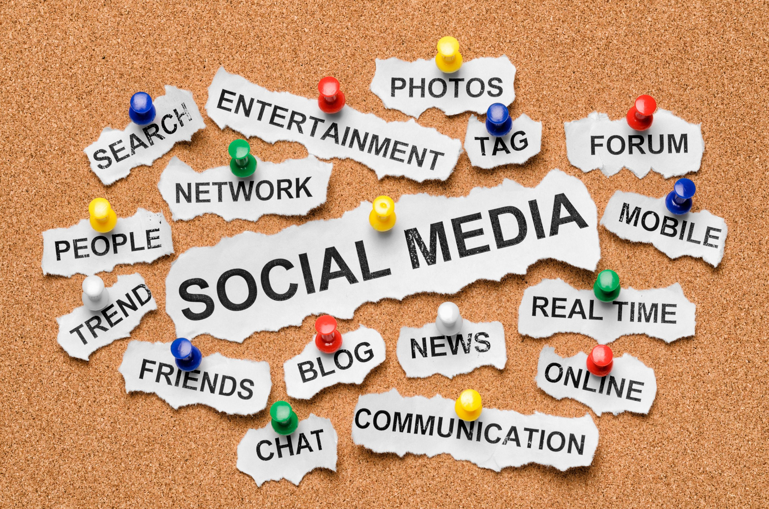
Introduction
In today’s digital world, social media has become an integral part of daily life, connecting billions of people worldwide.
Social media marketing leverages platforms like Facebook, Instagram, and Twitter to promote products, services, and brands through engaging content such as posts, images, and videos.
This marketing approach allows businesses to interact directly with their audience, build brand loyalty, and gain valuable insights from consumer feedback. With data-driven strategies, targeted advertising, and analytics, companies can optimize their campaigns for maximum impact and return on investment (ROI).
This study explores the key strategies, opportunities, and challenges of social media marketing in the ever-evolving digital landscape.

Slide 4
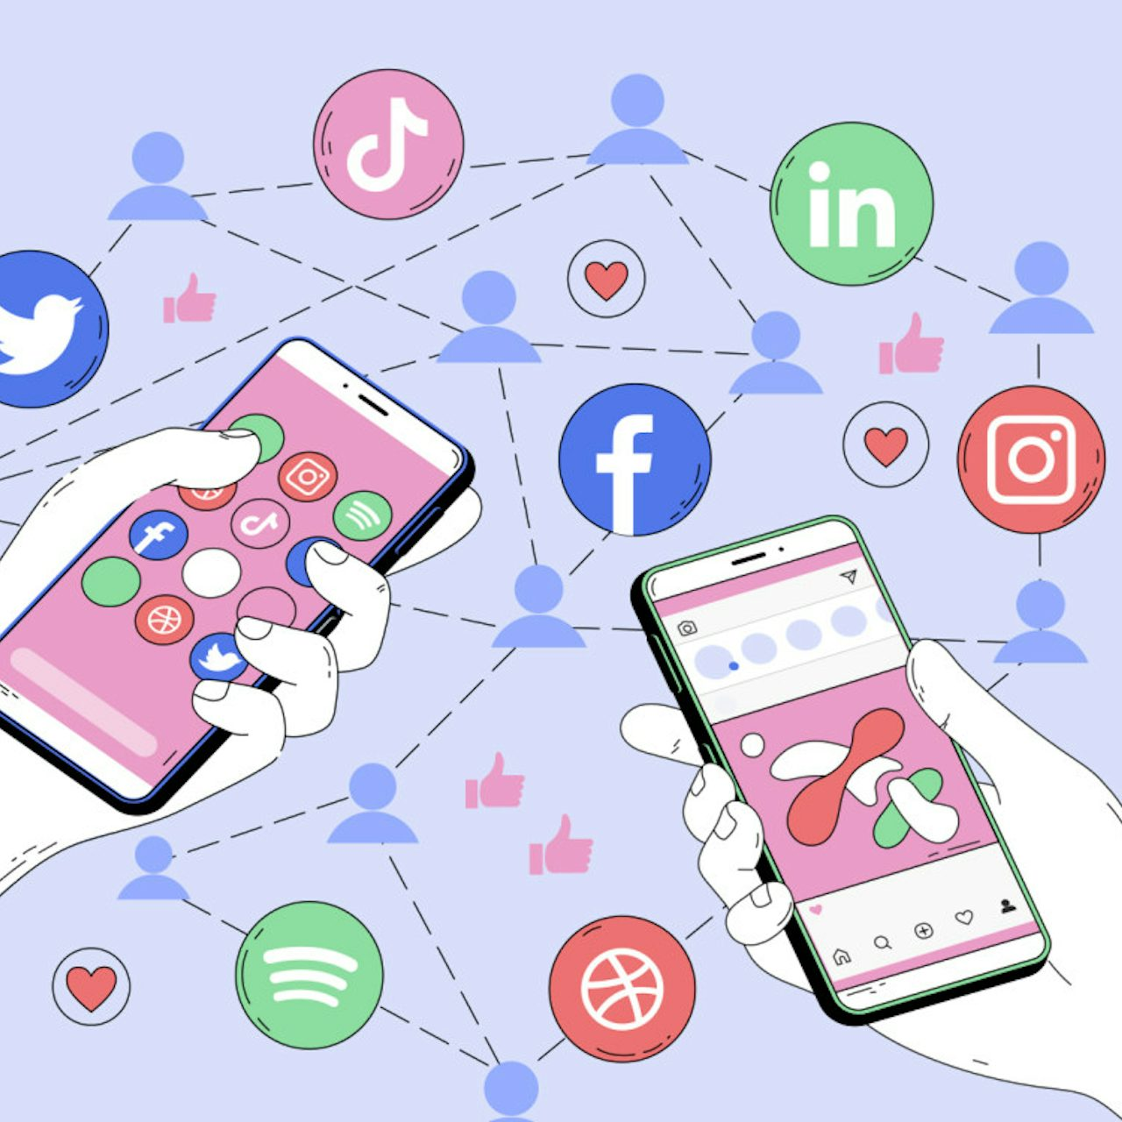
Problem Statement
A lot of businesses out there are really struggling to get the most out of it.
Despite their efforts, they often end up with low engagement and poor conversion rates.
The main reasons? Unclear messaging, inconsistent content, and not really understanding their audience.
What they need is a strategy that uses data analytics to better target their audience, engage customers, and build brand loyalty."

Slide 5
Research and Findings
🔍 Social Media Marketing is Growing Rapidly
🌍 4.95 billion people use social media worldwide (Source: Data portal 2024)
💰 Social media ad spending will reach $219.8 billion in 2025 (Statista)
📊 Which Platforms Work Best?
Instagram & TikTok – Best for engagement and influencer marketing
Facebook – Strong for ads and community building
LinkedIn – Best for B2B marketing and professionals
📈 Impact on Consumer Behavior
80% of users prefer buying from brands they follow on social media
Video content gets 1200% more shares than text & images

Slide 6
Opportunities of Social Media Marketing
🚀 1. Expanding Market Reach Social media marketing allows businesses to reach a vast audience, including international markets, without the need for physical expansion. This provides companies with opportunities to grow beyond their local customer base.
🎯 2. Cost-Effective Marketing Compared to traditional advertising methods, social media marketing is more affordable. Even small businesses can run budget-friendly campaigns and achieve significant brand exposure through organic content and paid promotion
💬 3. Direct Interaction with Consumers Brands can engage directly with their customers through comments, messages, and live chats. This two-way communication builds trust, strengthens relationships, and enhances customer satisfaction.
📢 4. Increased Brand Awareness & Visibility Social media platforms provide an opportunity to showcase products, services, and brand values to a large audience. Consistent and engaging content helps improve brand recognition and recall.
📈 5. Potential for Viral Marketing High-quality, engaging content has the potential to go viral, giving businesses massive exposure without additional costs. Creative campaigns, challenges, and trends can attract attention and boost brand popularity.

Slide 7
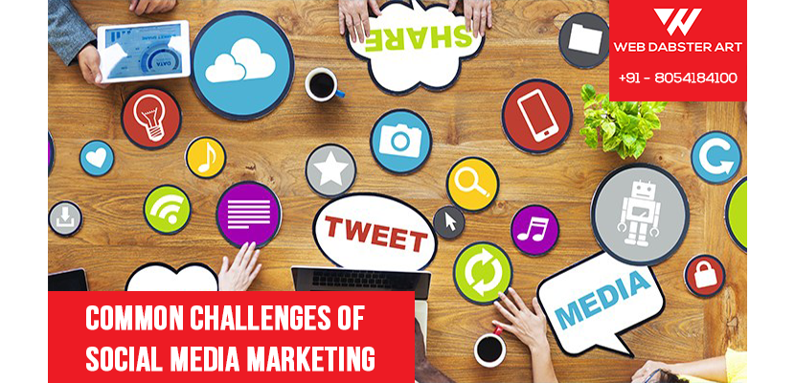
Challenges of Social Media Marketing
⚠️ High Competition Millions of businesses use social media, making it difficult to stand out in a crowded marketplace.
💰 Ad Costs & Budget Constraints Running paid campaigns can be expensive, especially for small businesses with limited budgets.
📉 Managing Negative Feedback Brands may face criticism, bad reviews, or negative comments, which can harm their reputation if not handled properly.
⏳ Time-Consuming Strategy Creating engaging content, responding to customers, and analyzing performance require continuous effort and time.
🔍 Privacy & Data Security Concerns Data breaches and privacy issues can impact customer trust in social media marketing practices.
factors.

Slide 8
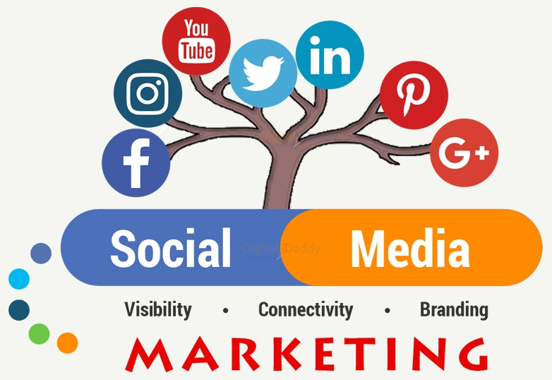
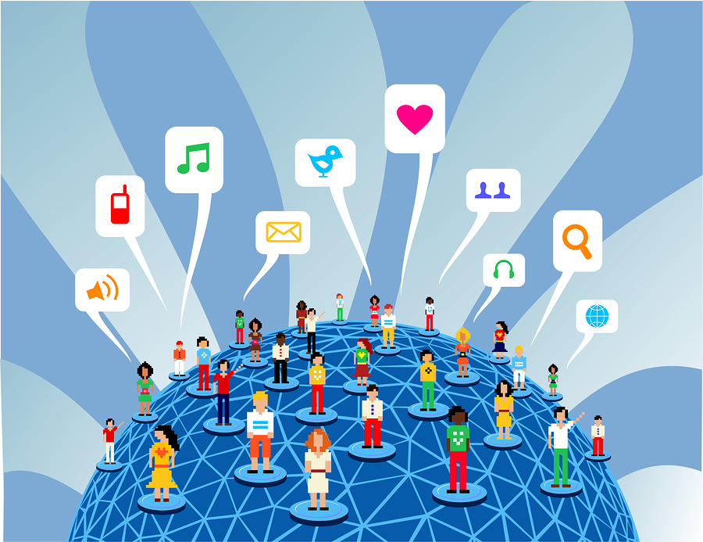
Conclusion
In conclusion, social media marketing presents a powerful opportunity for businesses to connect with their audience, enhance brand visibility, and drive growth. The ability to engage directly with consumers, leverage data analytics, and create targeted marketing campaigns enables brands to navigate the dynamic digital landscape effectively.
However, challenges such as high competition, constant algorithm changes, and the need for ongoing content creation must be addressed to maximize success. As the digital world continues to evolve, businesses must adapt their strategies, embrace innovative approaches, and remain responsive to consumer feedback.
Ultimately, by harnessing the potential of social media marketing while mitigating its challenges, brands can create meaningful connections with their audience and achieve sustainable growth in the marketplace.

